Slide 1
Introduction to H.264/AVC Fidelity Range Extensions
2008/04
MC2008, VCLAB

Slide 2
Outline
H.264/AVC version 1
H.264 FRExt Amendment
Intra Spatial Prediction
Transform
Quantization
Scanning
Lossless Macroblock Modes
Color Space
Residual Color Transform
Supplemental Information
Profiles
Levels
Experimental Results
Application Areas
2008/04
MC2008, VCLAB

Slide 3
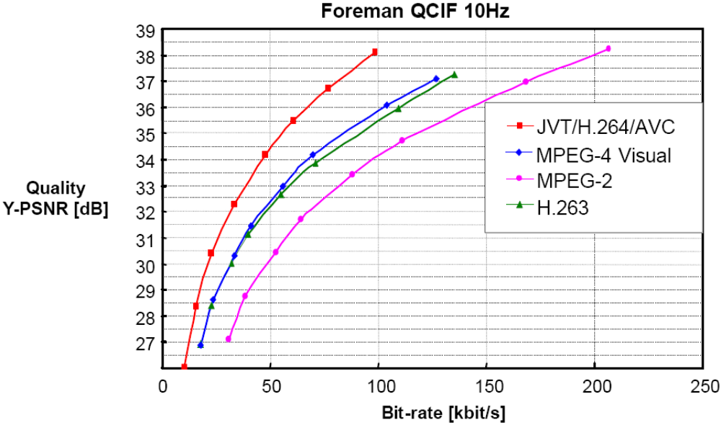
H.264/AVC version 1
Developed by Joint Video Team (JVT) from ITU-T’s Video Coding Experts Group (VCEG) and ISO/IEC’s Moving Picture Experts Group (MPEG)
The first version was finalized in March 2003
  Three profiles – Baseline, Extended, and Main
  Focus on “entertainment-quality” video
2008/04
MC2008, VCLAB

Slide 4
H.264/AVC version 1
Subjective picture quality evaluation with movie industry conducted by Blu-ray Disc Founders
  Sequences: Several movie clips provided by Hollywood movie studios
  Format: 1920*1080, 24fps 4:2:0 8-bit sampling
  Characteristic: The sequences contain various kinds of film grain
  Codecs: H.264/AVC Main Profile (fixed QP), MPEG-2 MP@HL (variable QP)
  Bitrates:7, 12, 15, 20, 24 Mbit/s
  Results:
    At the higher bitrate of 20, 24 Mbit/s for HD movie sequences that were tested: MPEG-2 provides better subjective picture quality than H.264/AVC.
    The current subjective picture quality for H.264/AVC is not sufficient for BD: Fine texture and film grain is missing.
    At the lower bitrate such as 15Mbps or less for HD movie sequences that were tested: both H.264/AVC and MPEG-2 show unacceptable picture due to unstable bouncing temporal noise.
2008/04
MC2008, VCLAB
JVT-K025r1

Slide 5
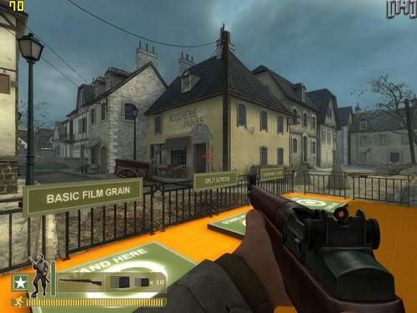
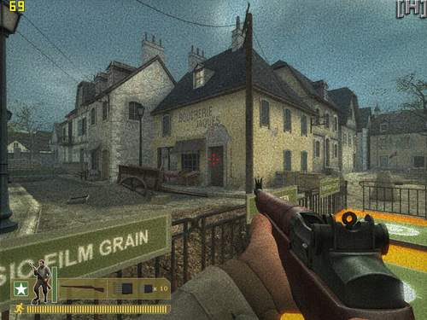
Film Grain
Day Of Defeat: Source
2008/04
MC2008, VCLAB
http://news3.pcnow.com.cn/2/lib/200601/20/20060120146.htm

Slide 6
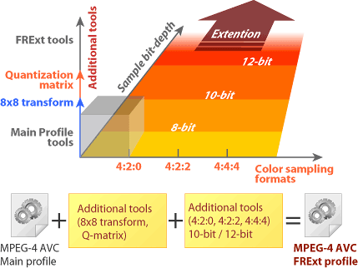
H.264 FRExt Amendment
Completed in July 2004
  For coding of high-fidelity video material
    Professional film production, video post production, or high-definition TV/DVD
    Higher quality, higher rates
  Professional extensions ⇒ Fidelity Range extensions (FRExt)
http://plusd.itmedia.co.jp/lifestyle/articles/0407/09/news074.html
2008/04
MC2008, VCLAB

Slide 7
H.264 FRExt Amendment
High profiles
  High profile (HP)
    Supporting 8-bit with 4:2:0 sampling
  High 10 profile (Hi10P)
    Supporting 10-bit with 4:2:0 sampling
  High 4:2:2 profile (H422P)
    Supporting 10-bit with 4:2:2 sampling
  High 4:4:4 profile (H444P)
    Supporting 12-bit with 4:4:4 sampling, and efficient lossless coding and an integer residual color transform for coding RGB video
2008/04
MC2008, VCLAB

Slide 8
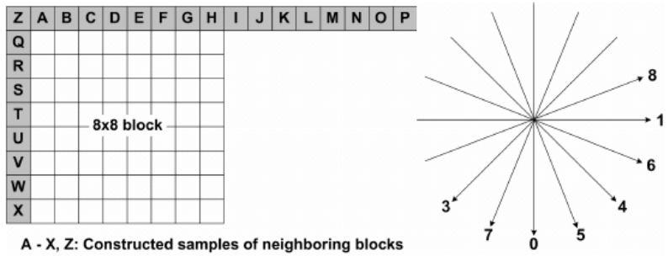
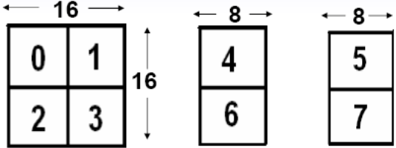
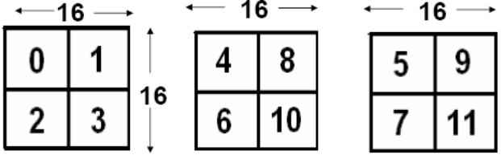
Intra Spatial Prediction
Luma Intra Prediction
  8x8 luma
    9 directions + DC prediction
    Second-order binomial filter to the predictor
Chroma Intra Prediction
  8x16 chroma in 4:2:2 macroblocks and 16x16 chroma in 4:4:4 macroblocks
    Vertical, horizontal, DC, and planar prediction
4:2:2
4:4:4
Luma
Chroma
Luma
Chroma
2008/04
MC2008, VCLAB

Slide 9
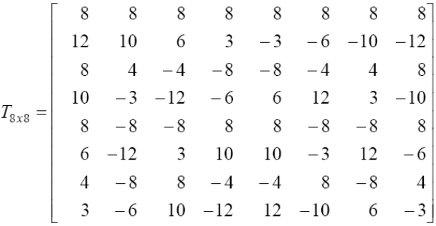
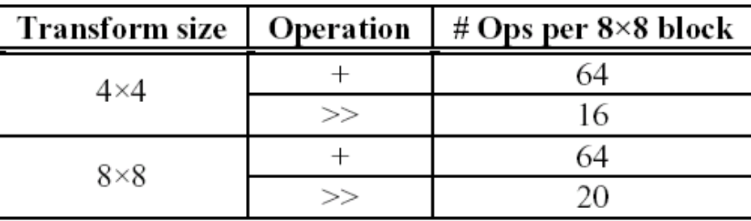
Transform
8x8 Integer Transformation
  Average BD bit-rate saving for progressive videos
    IPPP – 1 reference frame: 10.13%
    IPPP – 4 reference frames: 9.55%
    IBBP – 1 forward and 1 backward reference frames: 10.94%
  # of operations required for the 2D 4*4 and 8*8 inverse transform in H.264/AVC FRExt
“JVT-K028,” 11th meeting of JVT
Implemented by butterfly algorithm
2008/04
MC2008, VCLAB

Slide 10
Quantization
Perceptual-based quantization scaling matrices (HVS weighting matrices)
  Similar concept to MPEG-2 design
  Customized separately for
    4*4 Intra Y;
    4*4 Intra C_{b} and C_{r};
    4*4 Inter Y;
    4*4 Inter C_{b} and C_{r};
    8*8 Intra Y;
    8*8 Inter Y.
  Default or encoder-specified scaling matrices
  Used to improve subjective fidelity.
2008/04
MC2008, VCLAB

Slide 11
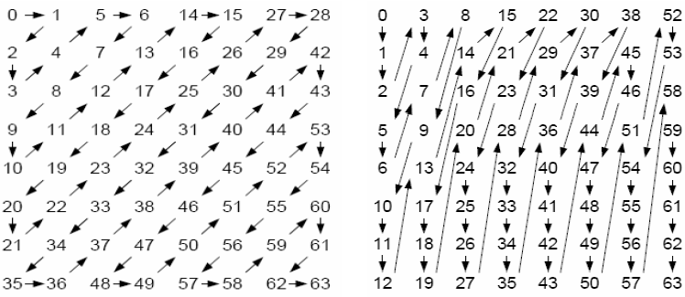
Scanning
Scanning order is similar to 4*4 luma
frame
field
2008/04
MC2008, VCLAB

Slide 12
Lossless Macroblock Modes
Motivations
  Sometimes encoding process might cause data expansion rather than compression when coding high-fidelity video
  Allow regions of the picture to be represented without any loss of fidelity
PCM mode in H.264/AVC version 1
  Values of the samples are sent directly without prediction, transformation, or quantization
  Not efficient
Transform-bypass lossless mode in FRExt
  Prediction → transform-bypass → entropy coding
  Only in Hi444P
2008/04
MC2008, VCLAB

Slide 13

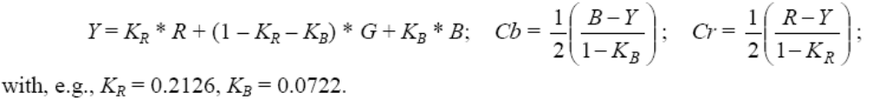

Color Space
RGB-to-YCbCr
  Rounding error due to forward and inverse color transform
  Higher complexity
    Difficult-to-implement coefficient values such as 0.2126 and 0.0722
RGB-to-YCgCo in FRExt
  For implementation,
  1-bit expansion of sample accuracy is necessary
capture
compression
display
RGB
YCbCr
RGB
2008/04
MC2008, VCLAB

Slide 14
Residual Color Transform
Retain the use of RGB for input and output frames and stored reference frames
Eliminate color-space conversion error without significantly increasing overall complexity
Applied to 4:4:4 video only
2008/04
MC2008, VCLAB

Slide 15
Supplemental Information
Extra information sent with compressed video data
  Supplemental enhancement information (SEI)
  Video usability information (VUI)
Auxiliary pictures, which are extra monochrome pictures sent along with the main video stream, and can be used for such purposes as alpha blend compositing (specified as a different category of data than SEI).
Film grain characteristics SEI, which allow a model of film grain statistics to be sent along with the video data, enabling an analysis-synthesis style of video enhancement wherein a synthesized film grain is generated as a post-process when decoding, rather than burdening the encoder with the representation of exact film grain during the encoding process.
Deblocking filter display preference SEI, which allows the encoder to indicate cases in which the pictures prior to the application of the deblocking filter process may be perceptually superior to the filtered pictures.
Stereo video SEI indicators, which allow the encoder to identify the use of the video on stereoscopic displays, with proper identification of which pictures are intended for viewing by each eye.
2008/04
MC2008, VCLAB

Slide 16
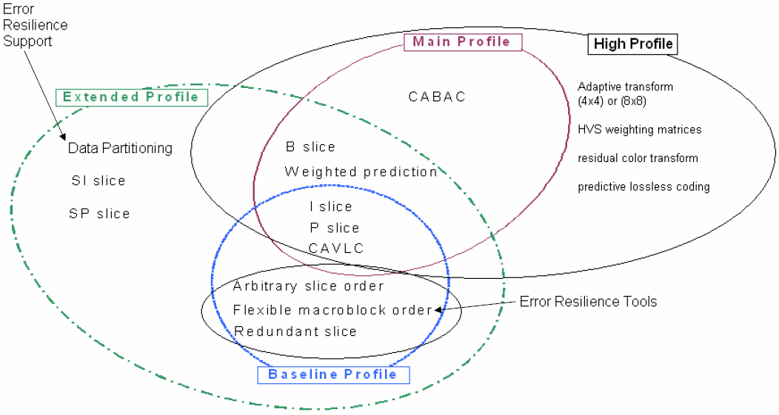
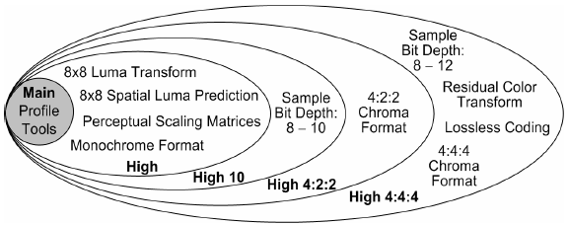
Profiles
2008/04
MC2008, VCLAB

Slide 17
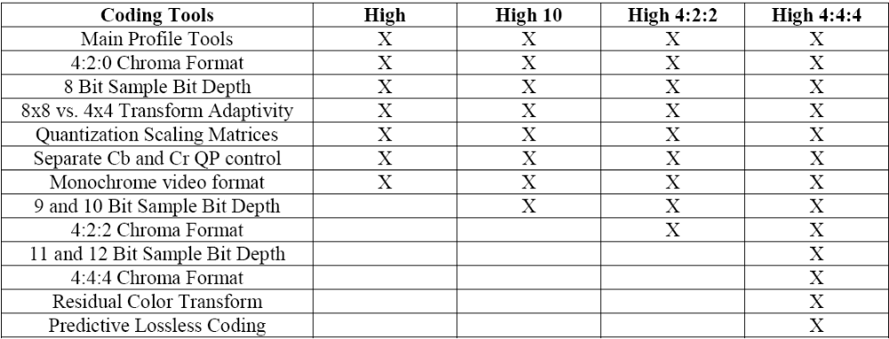
Profiles
High profiles
2008/04
MC2008, VCLAB

Slide 18
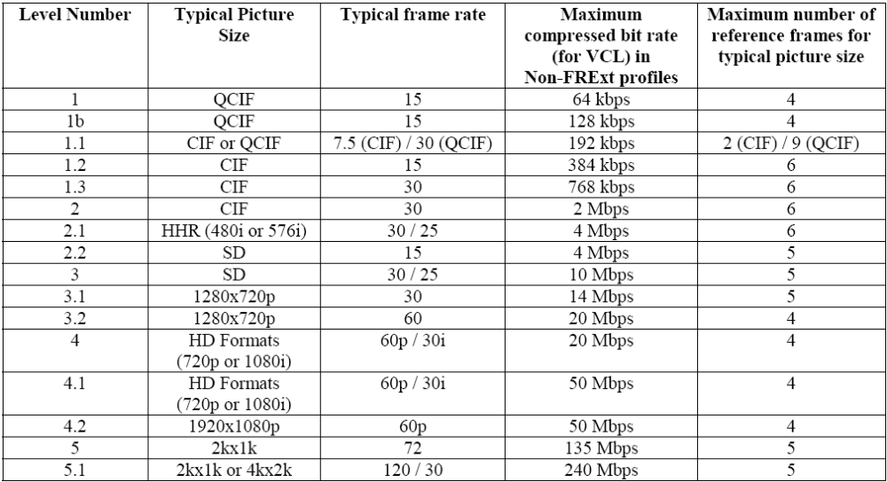
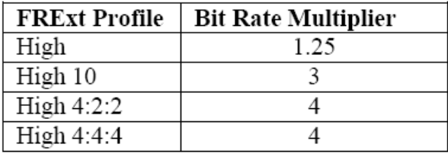
Levels
New!!
For 3G wireless environments
3G stands for the third generation of wireless communication technology. It refers to pending improvements in wireless data and voice communications through any of a variety of proposed standards. The immediate goal is to raise transmission speeds from 9.5K to 2M bit/sec.
From http://www.3gnewsroom.com/html/what_is_3g/index.shtml
2008/04
MC2008, VCLAB

Slide 19
Experiment 1
Environments
  H.264/AVC vs. MPEG-2 Main profile
  7 progressive HD sequences
  1280*720@60Hz and 1920*1080@24Hz
  The same RD optimization strategy
  I-frame interval: 500ms
  Two non-referenced B-frames between two successive P-frames
  Fullsearch, ± 32 integer pixels search range
  3 reference frames in H.264/AVC
2008/04
MC2008, VCLAB

Slide 20
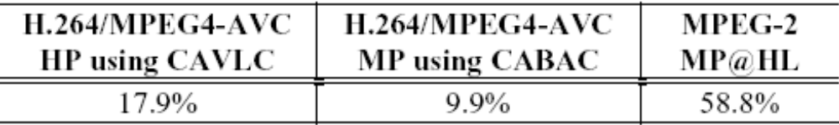
Experiment 1
Average bit-rate saving for H.264/AVC HP using CABAC in comparison with HP using CAVLC, MP using CABAC, and MPEG-2
Performance rank
2
1
3
2008/04
MC2008, VCLAB

Slide 21
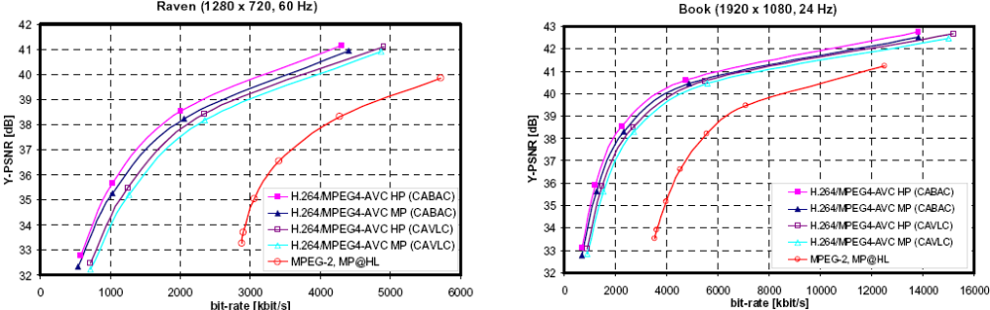
Experiment 1
Comparisons of Rate-Distortion
2008/04
MC2008, VCLAB

Slide 22
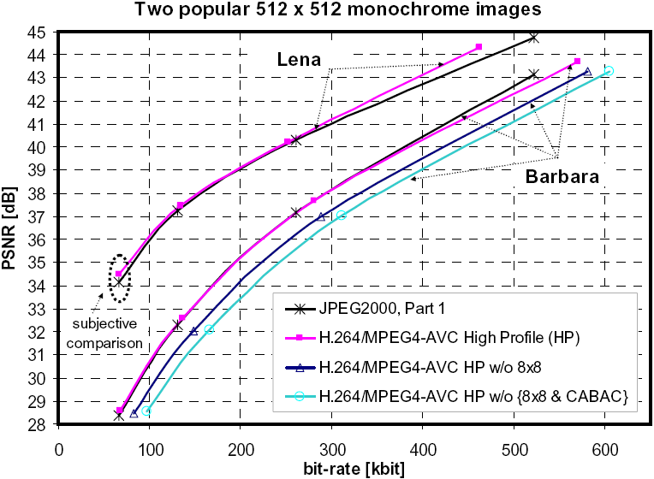
Experiment 2
H.264/AVC HP intra vs. JPEG2000
  Input: Lena and Barbara monochrome image
2008/04
MC2008, VCLAB

Slide 23
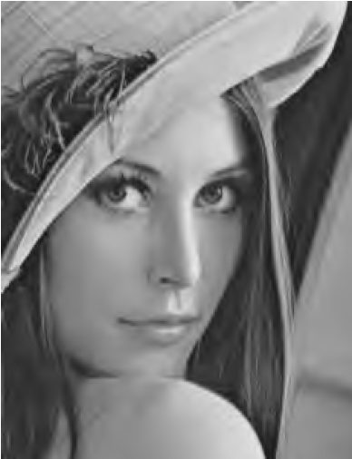

0.25 bpp
JPEG 2000
H.264/AVC HP
2008/04
MC2008, VCLAB

Slide 24
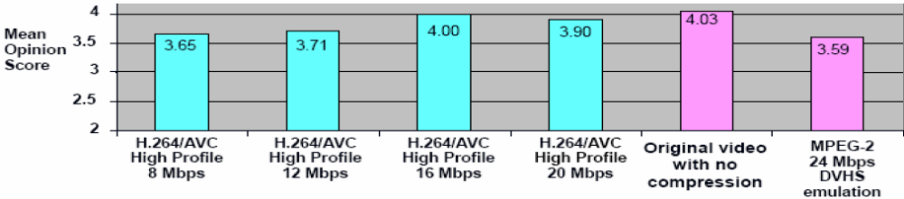
Experiment 3
Perceptual quality comparisons
  24 frame/sec at 1920*1080 progressive scanning
  The FRExt HP produced nominally better quality than MPEG-2 when using only one-third as many bits (8 Mbps vs. 24 Mbps)
2008/04
MC2008, VCLAB
Blu-ray Disc Association

Slide 25
Application Areas
The High profile with 8-bit video in 4:2:0 format is likely to replace the Main profile for prospective applications
Application standards or specifications for H.264/AVC HP
  TS 101 154 and TS 102 005 of DVB
  HD-DVD of the DVD Forum
  BD of the Blu-ray Disc Association
  地面數位電視接收機基本技術規範 _{(94.11.10)}
2008/04
MC2008, VCLAB

Slide 26
References
G. J. Sullivan, P. Topiwala, and A. Luthra, “The H.264/AVC Advanced Video Coding Standard: Overview and Introduction to the Fidelity Range Extensions,” in SPIE Conference on Applications of Digital Image Processing, 2004.
D. Marpe, T. Wiegand, and S. Gordon, “H.264/MPEG4-AVC Fidelity Range Extensions: Tools, Profiles, Performance, and Application Areas,” ICIP 2005.
Joint Video Team of ITU-T and ISO/IEC: “H.264/AVC for Next Generation Optical Disc: A Proposal on FRExt Profiles,” Doc. JVT-K025r1, 2004.
Joint Video Team of ITU-T and ISO/IEC: “Simplified Use of 8x8 Transforms – Updated Proposal & Results,” Doc. JVT-K028
地面數位電視接收機基本技術規範http://www.bsmi.gov.tw/upload/b03/hjj/HDTV_receive_technical_regulation.doc
「H.264/AVC改良版」で動き出すか？ 次世代光ディスク情勢 http://plusd.itmedia.co.jp/lifestyle/articles/0407/09/news074.html
2008/04
MC2008, VCLAB

